Slide 1
16th May 2018
Total Communication

Slide 2
The Communication Team….
We are a multi-disciplinary team
Work in collaboration with every class to ensure every pupil has a communication programme
Provide a range of additional support
Work on development projects

Slide 3
This morning we’ll talk about...
What Total Communication means
Why communication is so important
What is receptive & expressive language
How you might want to support your son or daughter with their receptive and expressive language at home.
Notes:
It will be very informal
Feel free to ask questions

Slide 4
A Little Ice Breaker!
Get into pairs
One person will be drawing, the other will be the communicator
Both of you imagine you don’t understand or use speech, reading or writing.
The communicator will face the board, the drawer will face the other way.
The communicator is going to describe a picture and the drawer will draw it! You have a couple of minutes!

Slide 5


Slide 6
How did that feel?
How did you communicate?
Notes:
This is what pupils experience on a daily basis

Slide 7
What is communication?
Communication is how we interact with others. It incorporates:
The use of non-verbal methods e.g. listening, looking, facial expression, body language.
How we understand others and the world around us (receptive skills)
How we make ourselves understood (expression)

Slide 8
Total Communication
Total Communication is a communication philosophy- not a communication method and not at all a teaching method………Total Communication is an approach to create a successful and equal communication between human beings with different language perception and/or production…….To use Total Communication amounts to a willingness to use all available means in order to understand and be understood’.
(Hansen)

Slide 9
Understanding
Total Communication
Expression

Slide 10
So why is Communication important?

Slide 11
‘Being able to communicate is the most important skill we need in life. Almost everything we do involves communication; everyday things such as personal care, getting basic needs met, learning, making friends and having fun rely on our ability to communicate with each other’
(Communication Trust)

Slide 12
All of our pupils need a total communication approach to enable them to communicate – in order to facilitate this we need a whole range of communication tools and systems. . .

Slide 13
“ Children will use the quickest, most effective, and most accessible way available to them to communicate. Speech beats any other AAC system if it is available to the child.
Available research indicates that AAC facilitates spoken language by increasing interaction, language skills, and/or providing a voice output model for speech”
(Cynthia J, Cress PHD)
Notes:
Anyone need a loo break or refil?

Slide 14
Receptive Language is
“ How we understand others & the world around us”
How we gain information
(what’s happening)
&
Developing a vocabulary
(understanding of words)
Notes:
For our pupils this could mean they have difficulties in 1 or more of the following;
Understanding spoken language
Listening
Processing & retaining information
Following instructions & directions

Slide 15
For our pupils developing their receptive skills enables them…
To demonstrate what they know
To understand, learn new skills and words
To regulate their behaviour
To support their emotional wellbeing
To have an element of control over their environment
To feel successful, empowered & independent

Slide 16
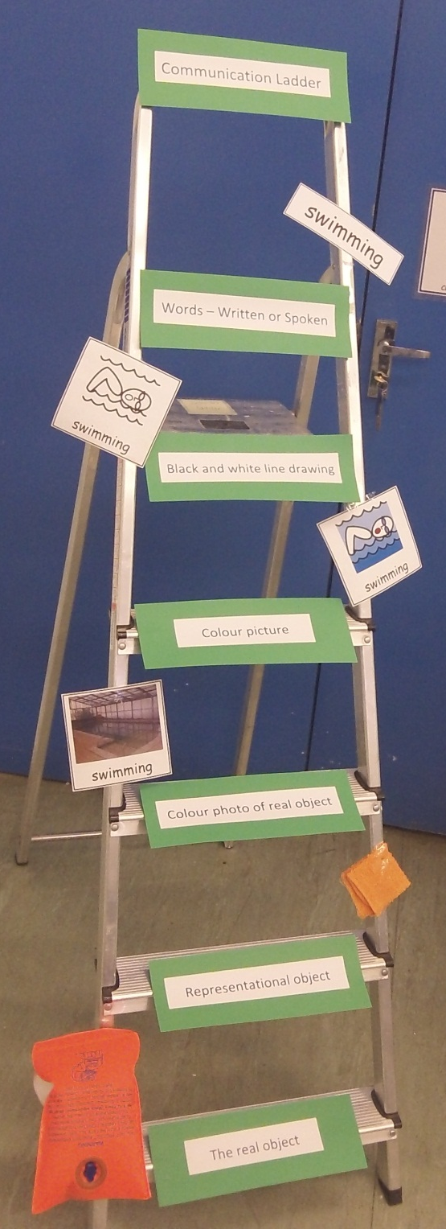
The Communication Ladder
6) Words; Written or spoken
5) Black & white symbol
4) Colour picture
3) Colour Photo’s
Pretend object, e.g. a toy
1) The real object
Notes:
KEY PART OF OUR TOTAL COMMUNICATION APPROACH
– This Ladder demonstrates the range of information giving systems that are available to our pupils.
- We start at the bottom of the ladder with the simplest representation of a word up to text/speech
Do all of you know where your child is on the ladder?

Slide 17
‘visuals are useful in helping a child to make sense of routines, to understand what is going to happen next….. If you use visuals to back up your language, you are giving pupils two chances to understand – they can hear your words and see the visuals. The visuals stay there, spoken words disappear!!!’

Slide 18
Systems to support receptive language
Cue your child in to what’s happening by using simple clear language
You can support key words with objects, sounds, signs, photos, symbols and written words (depending on their level of understanding).
Teach your child key words e.g. more, finish, help, toilet, cuddle, play, food, share, my turn/your turn, stop, go, drink…..
Notes:
Being at school is very different to being at home – we can have everything set up in a very structured way– home life is much more fluid!
Don’t feel under pressure to do everything at once. Start slow

Slide 19
Systems to support understanding
Use simple routine cards
Your phone is great for photo’s, sounds
The way things are laid out e.g. things kept in the same place so they learn where to find things
Countdowns to activities finishing and telling your child when something has finished
Notes:
Photos of people, houses, places (google images) make it really easy and simple for yourself. Chat to your childs class team.
What ever you use try to be as consistent as you can.
Few minutes to look at the display

Slide 20
What is Expressive Language?
At Glyne Gap language is described as the comprehension of a vocabulary (receptive language) and how this vocabulary is used
(expressive language).
Notes:
methods of communication- verbal and AAC, non verbal
reasons for communicating
Using their skills all the time with familiar/unfamiliar people in different places

Slide 21
Speech is the sounds used to produce words. This includes how people speak, the fluency, volume, intonation and pitch used to support meaning.
AAC is every communication method other than speech!
Notes:
A slight aside….

Slide 22
For our pupils developing their expressive skills enables them...
To have a chat, interact with someone
To gain someone's attention
To get what they want!
To express how they feel and what they think
To reject
To repair communication
To comment
To give information
To negotiate
To ask questions
To have a laugh!
These are just a few!!!

Slide 23
The Communication Ladder
6) Words; Written or spoken
5) Black & white symbol
4) Colour picture
3) Colour Photo’s
Pretend object, e.g. a toy
1) The real object
Notes:
We all use a mixture of these plus our non verbal cues
Do all of you know where your child is on the ladder?

Slide 24
Examples of systems to support expression..
Objects (e.g. pointing to a choice)
Photos – PECS, choiceboards,books….
Symbols – as above
Text – phone, written, computer, books
Written and drawn messages
Signs
Step by step/ big mack
Individuals own signals
Notes:
A child’s system will depend on a child’s skills, abilities and preferences
Every childs communication system is individualised
Refer to the display few minutes to look

Slide 25
How to be super communication partners!
Be positive when using a range of methods yourself
Model, model, model!
Slightly extend what your child says
Allow time for your child to process what you have said
Providing opportunities to use the communication systems!
Keeping systems up to date
Liaising with your child’s class team
Have fun!!!!!!!
Notes:
sabotage is a great tool as is sitting on your hands! Give your child as many opportunities as you can
Don’t guess what a pupil is trying to express before they finish!
let pupils think about how they can get their message across, we need to encourage them to make their communication as clear as possible

Slide 26
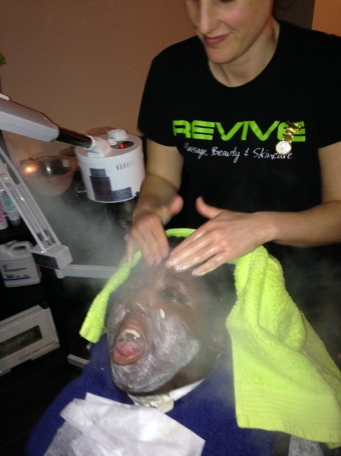
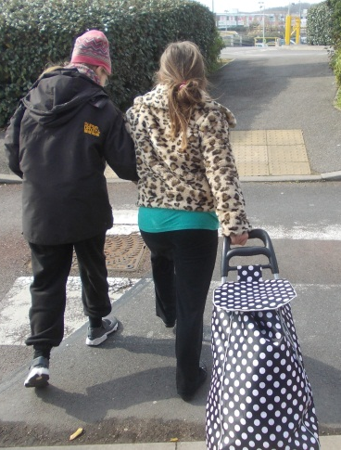
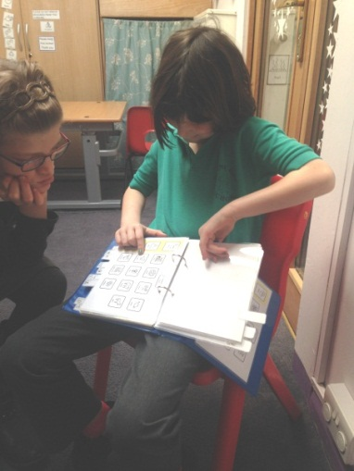
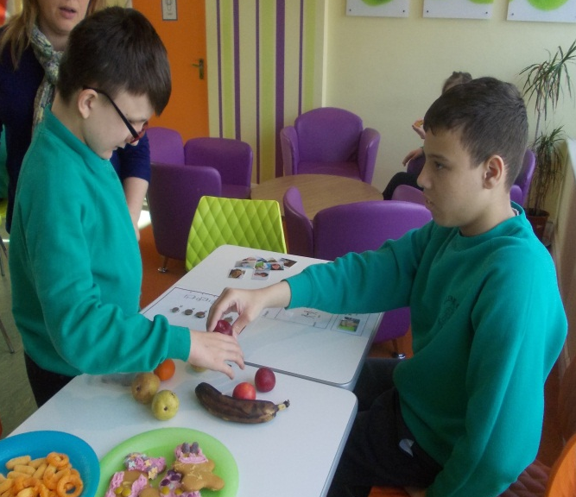
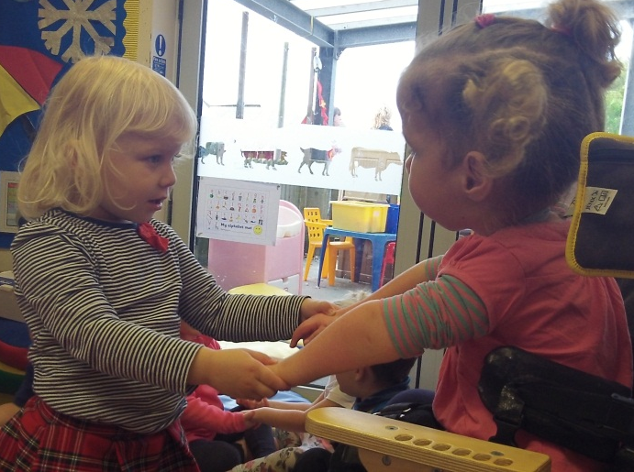
Developing Communication enables children to……
Enjoy a good gossip with my friends!
Participate no matter what I need to communicate
Express what leisure opportunities I like!
Make new friends and play!
Be independent as independent as I can be!
Notes:
These are just a few….

Slide 27
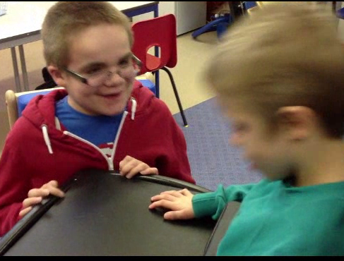
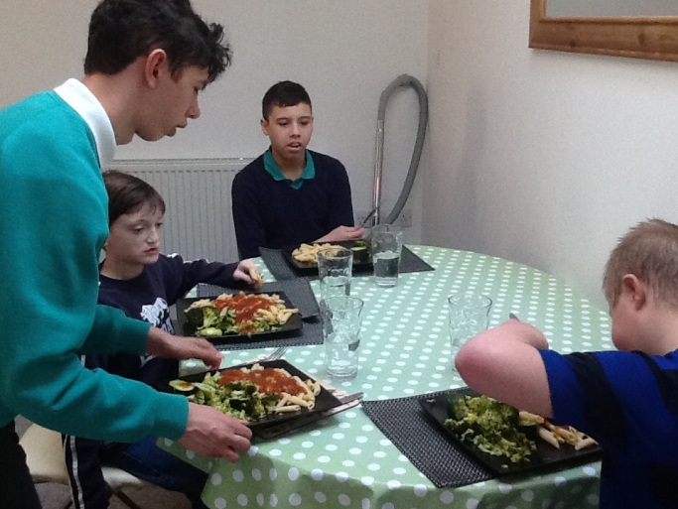
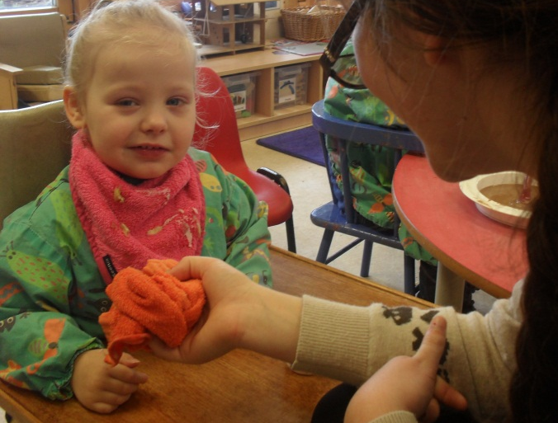
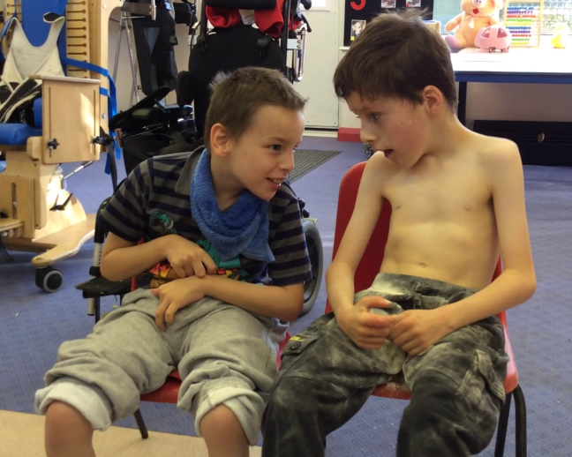
Having a chat with my friend….
Making lunch with the lads!
Considering what I want my future to be….
Thank you for coming..
Any questions?

